Slide 1


Asraful Islam
20 Sep 2022

Slide 2

Outline
Executive Summary
Introduction
Methodology
Results
Conclusion

Slide 3
Executive Summary
Summary of methodologies
Data collection
Data wrangling
EDA with data visualization
EDA with SQL
Building an interactive map with Folium
Building a Dashboard with Plotly Dash
Predictive analysis
Summary of all results
EDA results
Interactive analysis
Predictive analysis

Slide 4
Introduction
Project background and context
SpaceX advertises Falcon 9 rocket launches on its website with a cost of 62 million dollars; other providers cost upward of 165 million dollars each, much of the savings is because SpaceX can reuse the first stage
Problems we want to find answers
The project task is to predict if the first stage of the SpaceX Falcon 9 rocket will land successfully

Slide 5

Section 1

Slide 6
Methodology
Executive Summary
Data collection methodology:
SpaceX Rest API
Web Scrapping from wikipedia
Perform data wrangling
One Hot Encoding data fields for Machine Learning and data cleaning of null values and irrelevant columns
Perform exploratory data analysis (EDA) using visualization and SQL
Perform interactive visual analytics using Folium and Plotly Dash
Perform predictive analysis using classification models
Logistic Regression, KNN, SVM, Tree models have been built and evaluated for the best classifier

Slide 7
Data Collection: SpaceX Launch data
Import libraries
requests, pandas as pd, numpy as np, datetime
Get requests
space_url = “https://api.spacexdata.com/v4/launches/past"
Response = requests.get.(space_url)
View as json object
response.json()
Convert json object into dataframe
data = pd.json_normalize(response.json())

Slide 8
Data Collection: Falcon 9 Launch records
Define functions
getBoosterVersion, getLaunchSite, getPayloadData, and getCoreData
Get Endpoint data
getBoosterVersion(data), getLaunchSite(data) … … …
Filter data by Falcon 9
data_falcon9 = data[data['BoosterVersion']=='Falcon 9']
Dealing with missing values
data_falcon9['PayloadMass'].replace(np.nan, data_falcon9['PayloadMass'].mean(), inplace=True)
github =

Slide 9
Data Collection: SpaceX Falcon 9 - Scraping
Import libraries
sys, requests, BeautifulSoup, re, unicodedata, pandas
Get request and parse html
response = requests.get(static_url)
soup = BeautifulSoup(response.text, 'html.parser')
html_tables = soup.find_all('table’)
column_names = []
for item in first_launch_table.find_all('th’):
column_names.append(extract_column_from_header( item))
Extract column names
Extract rows and create data frame
Launch_dict = … … … # github reference
df = pd.DataFrame.from_dict(launch_dict, orient='index').transpose()
Static_url = t.ly/iLF6
Github:

Slide 10
Data Wrangling: Space X Falcon 9
Load SpaceX dataset
df = pd.read_csv(‘url’)
Calculate the no. of launches on each site, no. and occurrence each orbit and mission outcomes per orbit type
df.LaunchSite.value_counts()
df.Orbit.value_counts()
landing_outcomes=df.Outcome.value_counts()
Identify unsuccessful outcome
for i,outcome in enumerate(landing_outcomes.keys()):
print(outcome)
bad_outcomes=set(landing_outcomes.keys()[[1,3,5,6,7]])
landing_class = []
for x in df.Outcome:
if x in bad_outcomes:
landing_class.append(0)
else:
landing_class.append(1)
Create landing outcome class

Slide 11
EDA with Data Visualization
Scatter plot to show the relationship between Flight number and Launch Site
Scatter plot to show the relationship between Payload and Launch Site
Bar plot to show the relationship success rate of each orbit type
Scatter plot to show the relationship between Flight number and Orbit type
Scatter plot to show the relationship between Payload and Launch Site
Line plot to show the trend of yearly Launch success
Github:

Slide 12
EDA with SQL
Summary of the SQL queries:
Display the names of the unique launch sites in the space mission
Display 5 records where launch sites begin with the string 'CCA'
Display the total payload mass carried by boosters launched by NASA (CRS)¶
Display average payload mass carried by booster version F9 v1.1
List the date when the first succesful landing outcome in ground pad was acheived.
List the names of the boosters which have success in drone ship and have payload mass greater than 4000 but less than 6000
List the total number of successful and failure mission outcomes
List the names of the booster_versions which have carried the maximum payload mass. Use a subquery
List the records which will display the month names, failure landing_outcomes in drone ship ,booster versions, launch_site for the months in year 2015.
Rank the count of successful landing_outcomes between the date 04-06-2010 and 20-03-2017 in descending order.
Github:

Slide 13
Build an Interactive Map with Folium
Mark all launch sites on a map to give an intuitive insight about where the launch sites are located
Mark the success/failed launches for each site on the map to see which sites have high success rates
Calculate the distances between a launch site to its proximities to explore and analyse the proximities of launch sites
GitHub URL

Slide 14
Build a Dashboard with Plotly Dash
Create Launch Site drop-down and pie chart on success rate (class=0 vs class=1 ) to see which one has the largest success count
Create Range Slider to select Payload
Plot a scatter plot with the x axis to be the payload and the y axis to be the launch outcome (i.e., class column). To observe how payload may be correlated with mission outcomes for selected site(s).
Github:

Slide 15
Predictive Analysis (Classification)
Import libraries
Matplotlib.pyplot, seaborn, sklearn, preprocessing, train_test_split, GridSearchCV, LogisticRegression, SVC, DecisionTreeClassification, KNeighborsClassifier
Standardized data
data = pd.read_csv(‘url_1’), X = pd.read_csv(‘url_2’)
Y = data[‘class’].to_numpy
Transform = preprocessing.StandardScalaar()
Split test and train data
X_train, X_test, Y_train, Y_test = train_test_split(X, Y, test_size=0.2, random_state=2)
parameters ={"C":[0.01,0.1,1],'penalty':['l2'], 'solver':['lbfgs']}# l1 lasso l2 ridge
lr=LogisticRegression()
logreg_cv = GridSearchCV(estimator=lr, cv=10, param_grid=parameters)
logreg_cv.fit(X_train, Y_train)
yhat=logreg_cv.predict(X_test)
plot_confusion_matrix(Y_test,yhat)
Logistic regression and confusion matrix

Slide 16
Predictive Analysis (Classification)
SVM model and confusion matrix
parameters = {'kernel':('linear', 'rbf','poly','rbf', 'sigmoid’), 'C': np.logspace(-3, 3, 5), 'gamma':np.logspace(-3, 3, 5)}
svm = SVC()
svm_cv = GridSearchCV(estimator=svm, cv=10, param_grid=parameters)
svm_cv.fit(X_train, Y_train)
yhat=svm_cv.predict(X_test)
plot_confusion_matrix(Y_test,yhat)
Tree model and confusion matrix
parameters = {'criterion': ['gini', 'entropy'],
'splitter': ['best', 'random'],
'max_depth': [2*n for n in range(1,10)],
'max_features': ['auto', 'sqrt'],
'min_samples_leaf': [1, 2, 4],
'min_samples_split': [2, 5, 10]}
tree = DecisionTreeClassifier()
yhat = svm_cv.predict(X_test)
plot_confusion_matrix(Y_test,yhat)

Slide 17
Predictive Analysis (Classification)
KNN model and confusion matrix
parameters = {'n_neighbors': [1, 2, 3, 4, 5, 6, 7, 8, 9, 10],
'algorithm': ['auto', 'ball_tree', 'kd_tree', 'brute'], 'p': [1,2]}
KNN = KNeighborsClassifier()
knn_cv = GridSearchCV(estimator=KNN, cv=10, param_grid=parameters)
knn_cv.fit(X_train, Y_train)
yhat = knn_cv.predict(X_test)
plot_confusion_matrix(Y_test,yhat)
Test accuracy of logistic regression model
logreg_cv.best_score_.round(5)
logreg_cv.score(X_test, Y_test)
Test accuracy of SVM model
svm_cv.best_score_.round(5)
svm_cv.score(X_test, Y_test).round(5)

Slide 18
Results
Low weighted payloads perform better that that of the heavier payloads
Orbit GEO, HEO, SSO, ES L 1 have the best success rate
The success rates for the SpaceX launches is moderately proportional to the years they are eventually launched
The SVM, KNN, and Logistic Regression models ate the best in terms of prediction accuracy for the dataset

Slide 19

Section 2

Slide 20
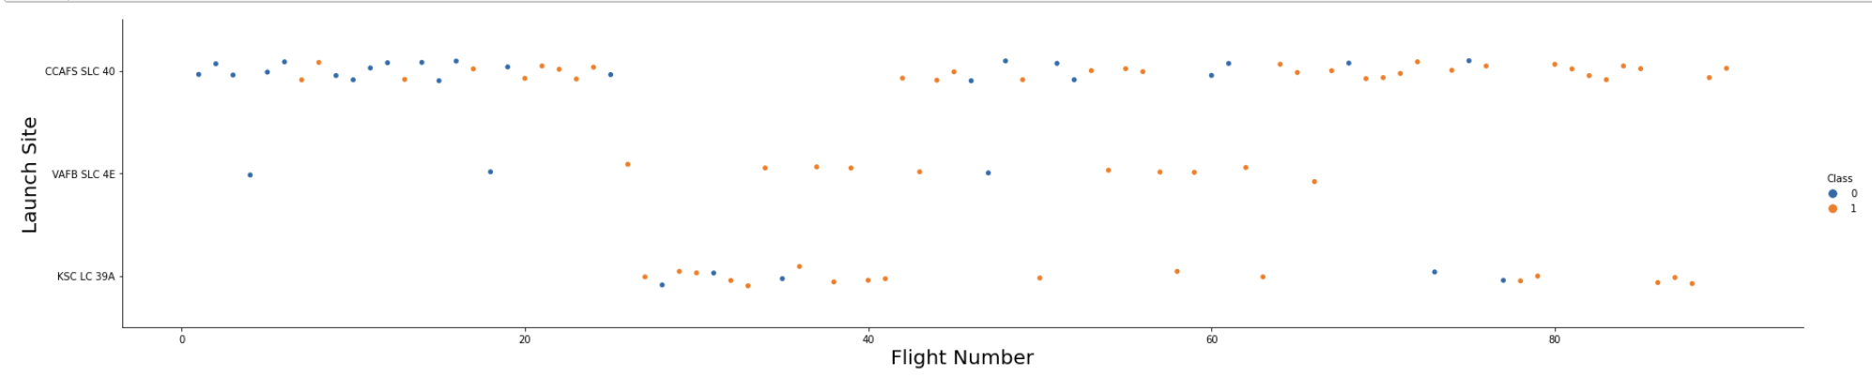
Flight Number vs. Launch Site
Launches from the site of CCAFS SLC 40 are significantly higher than that of the other sites

Slide 21
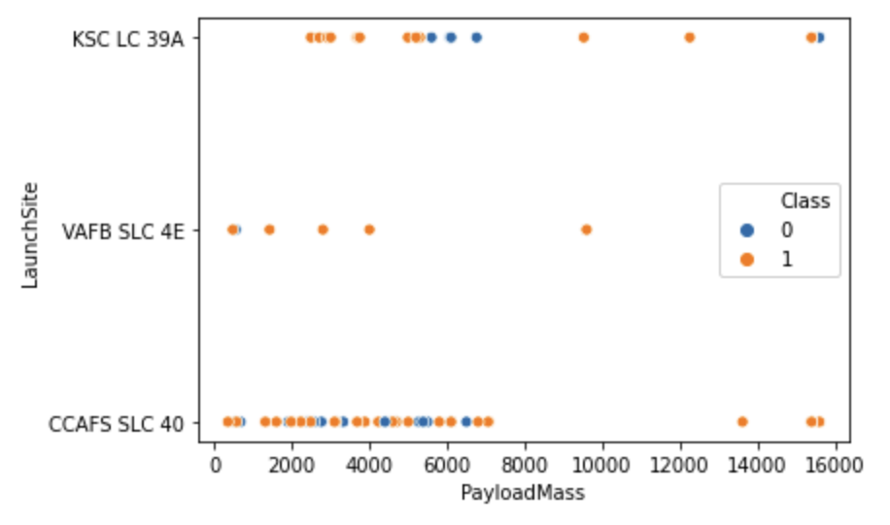
Payload vs. Launch Site
The rockets of lower payload mass have been launched from CCAFS SLC 40
The VAFB SLC 4E launch site has higher percentage of success rate regardless of payload mass

Slide 22
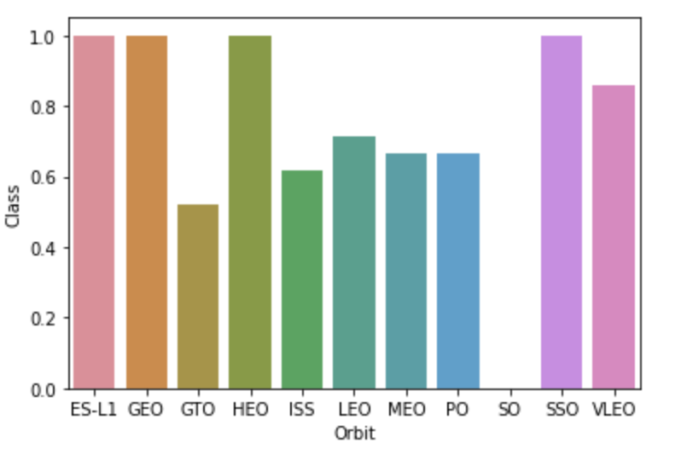
Success Rate vs. Orbit Type
The orbit types ES-L1, GEO, HEO, SSO are among the highest success rate

Slide 23
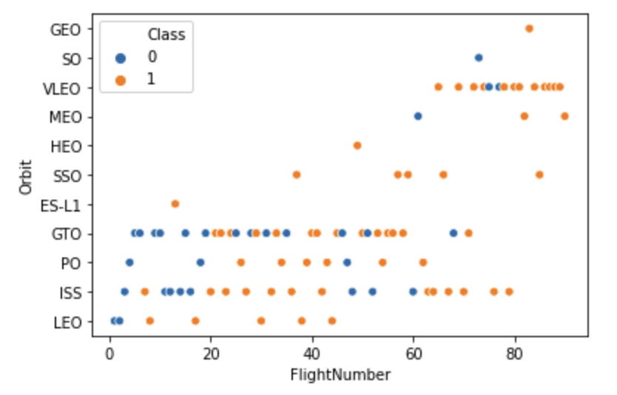
Flight Number vs. Orbit Type
In the LEO orbit the Success appears related to the number of flights
There is no relationship between flight number when in GTO orbit

Slide 24
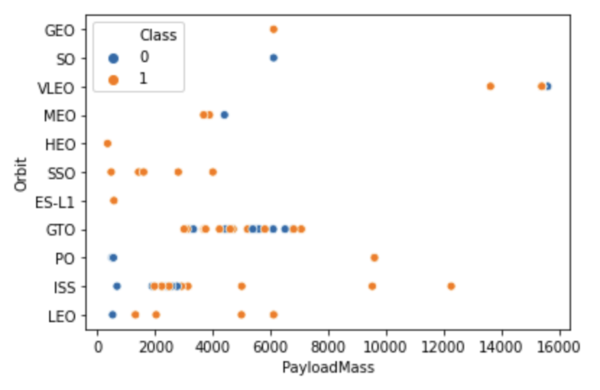
Payload vs. Orbit Type
With heavy payloads the successful landing or positive landing rate are more for Polar, LEO, and ISS
For GTO both successful and unsuccessful landing are hard to be distinguished

Slide 25
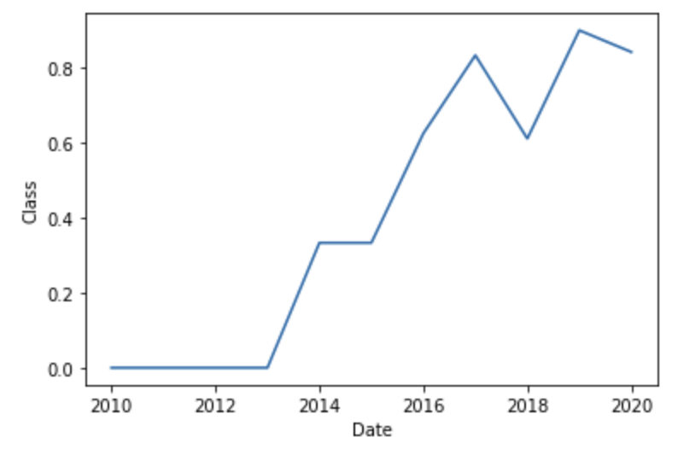
Launch Success Yearly Trend
Launch success rate since 2013 kept increasing till 2020
There was a little fall down of success rate from 2017 to 2018

Slide 26
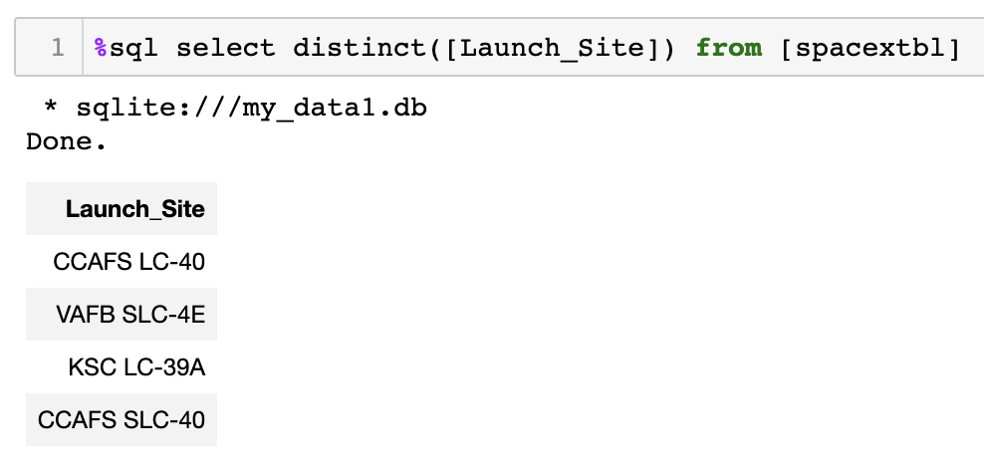
All Launch Site Names

Slide 27
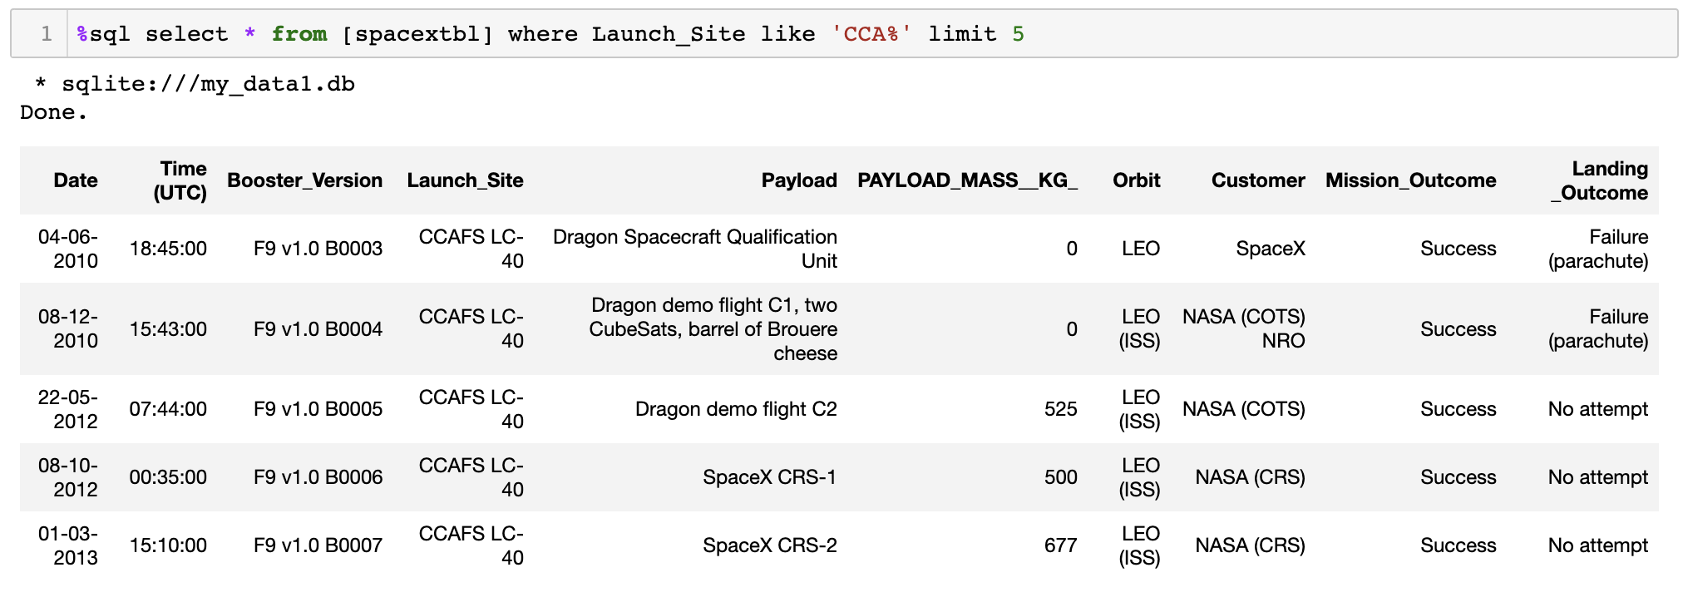
Launch Site Names Begin with 'CCA'

Slide 28
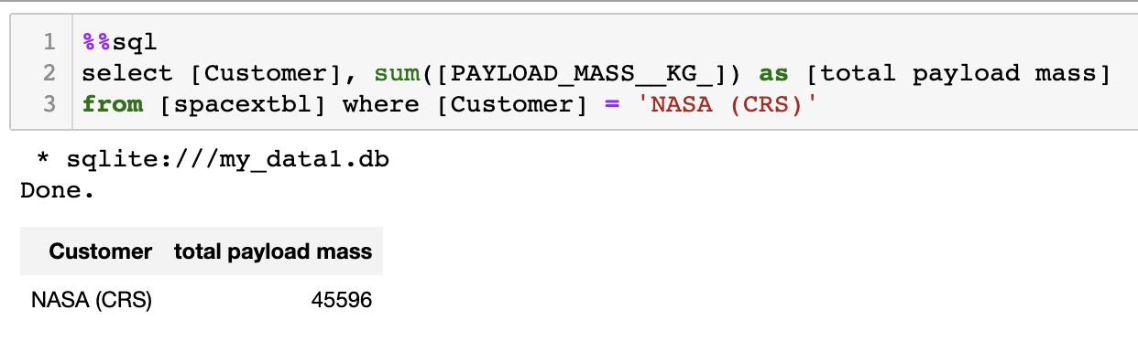
Total Payload Mass

Slide 29
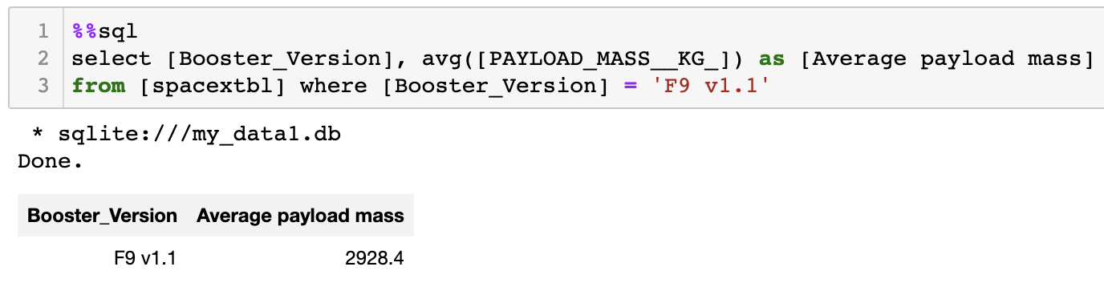
Average Payload Mass by F9 v1.1

Slide 30
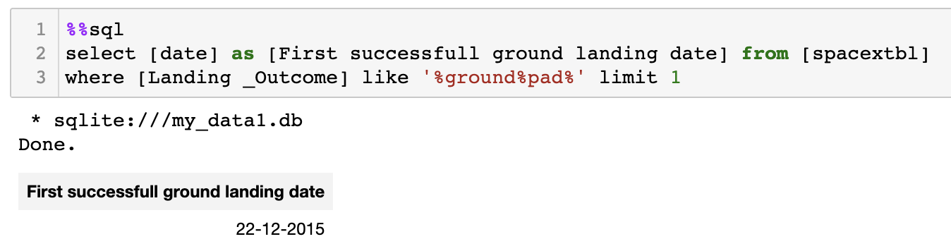
First Successful Ground Landing Date

Slide 31
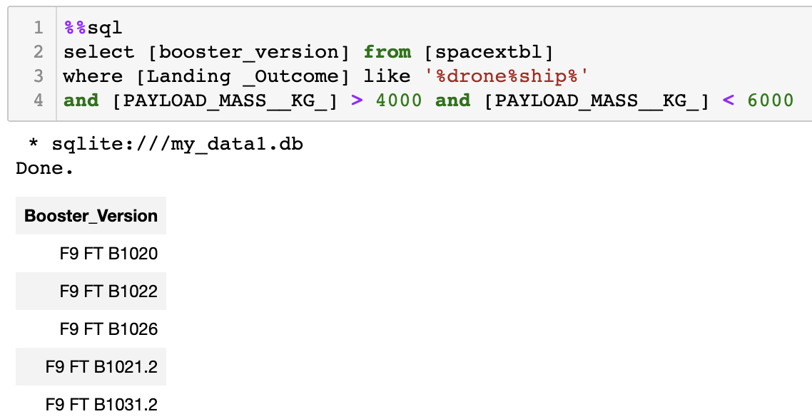
Successful Drone Ship Landing with Payload between 4000 and 6000

Slide 32
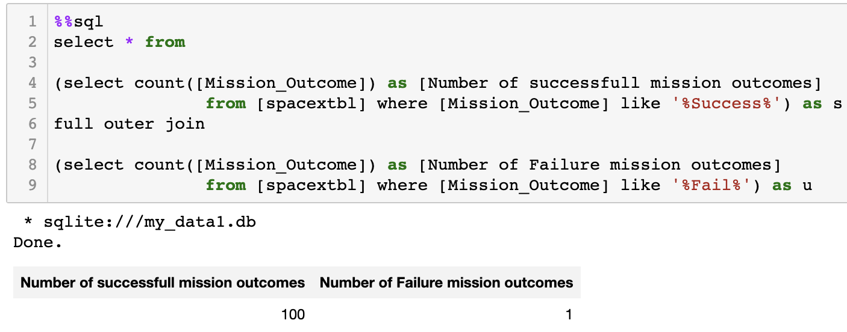
Total Number of Successful and Failure Mission Outcomes

Slide 33
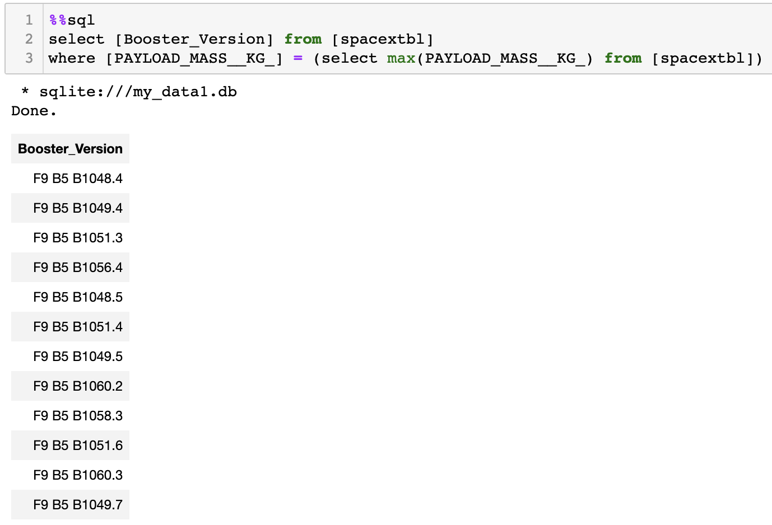
Boosters Carried Maximum Payload

Slide 34
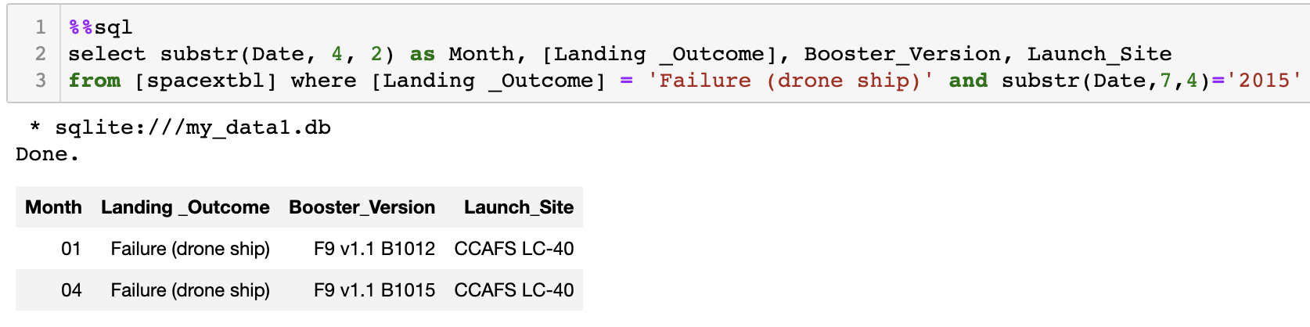
2015 Launch Records

Slide 35
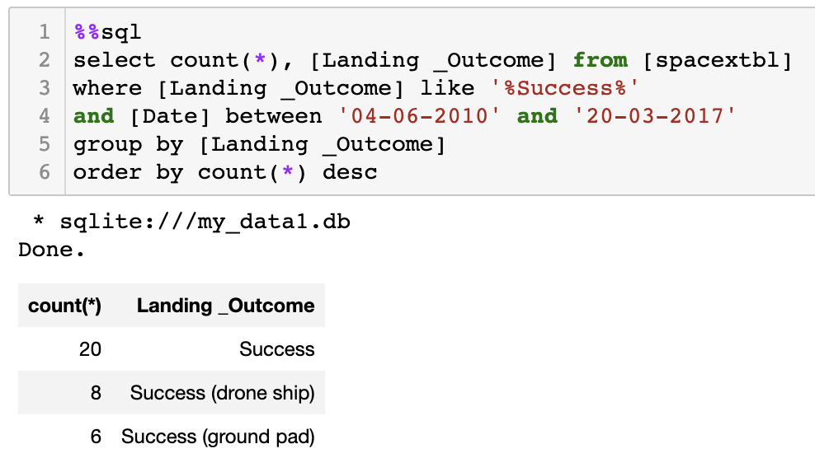
Rank Landing Outcomes Between 2010-06-04 and 2017-03-20

Slide 36

Section 3

Slide 37
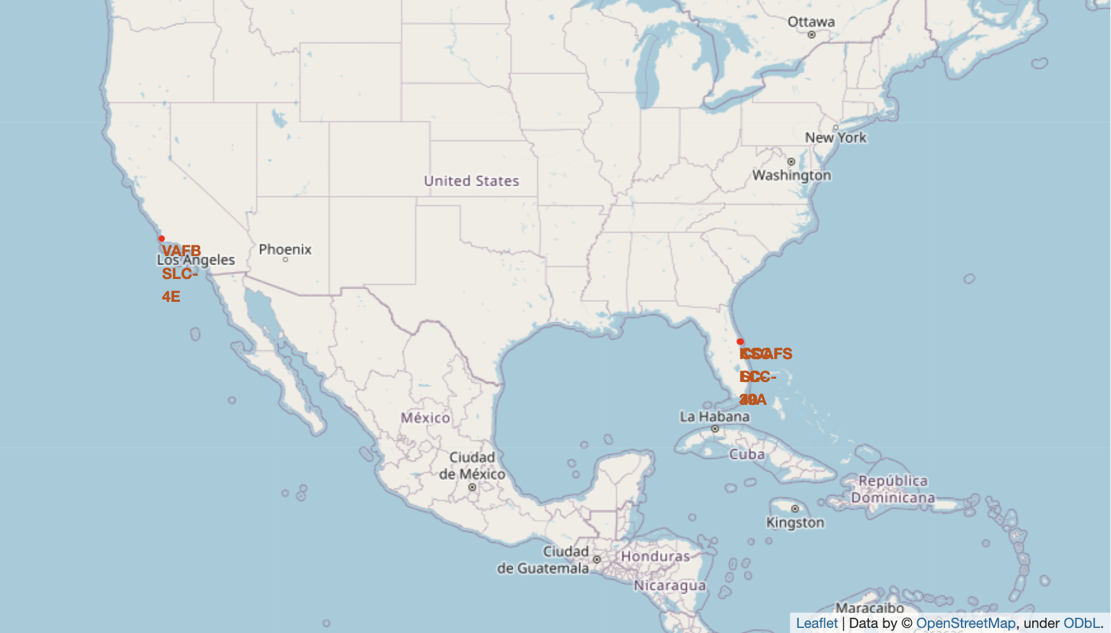
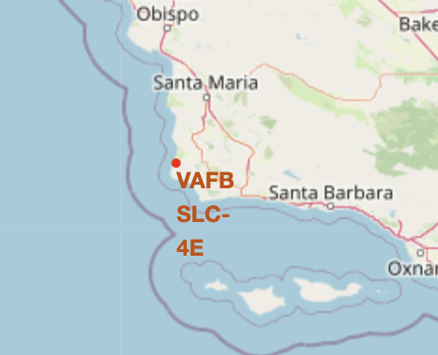
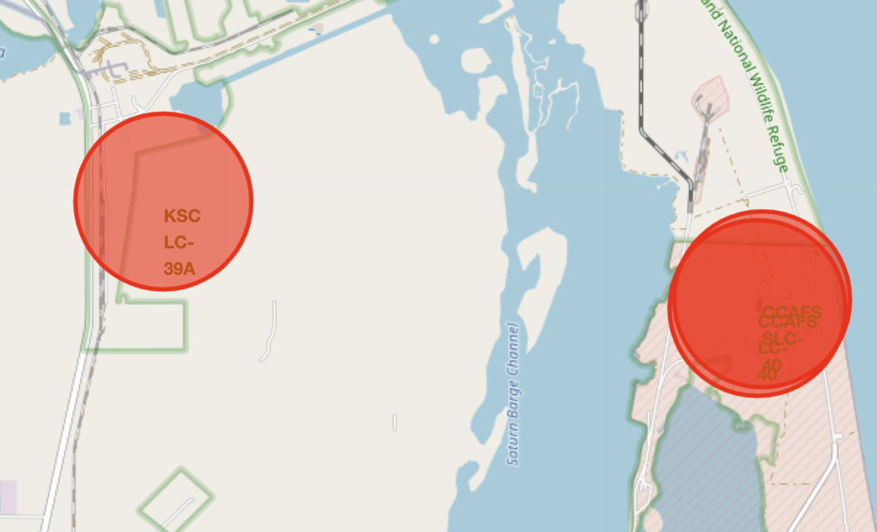
All launch sites on a map

Slide 38
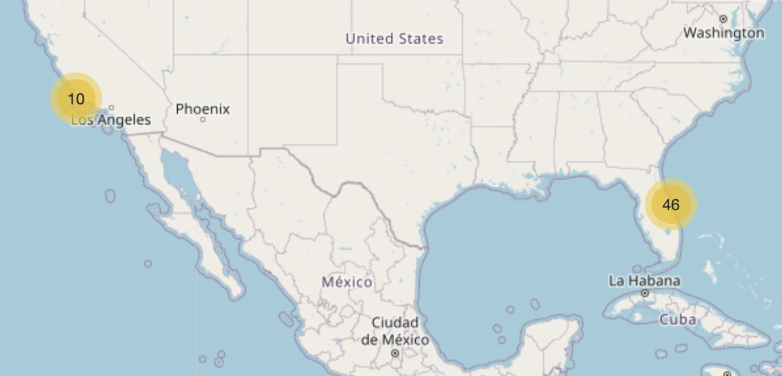
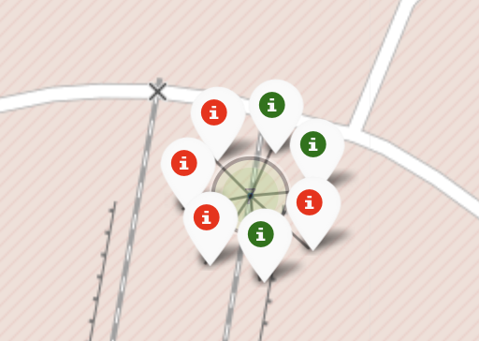
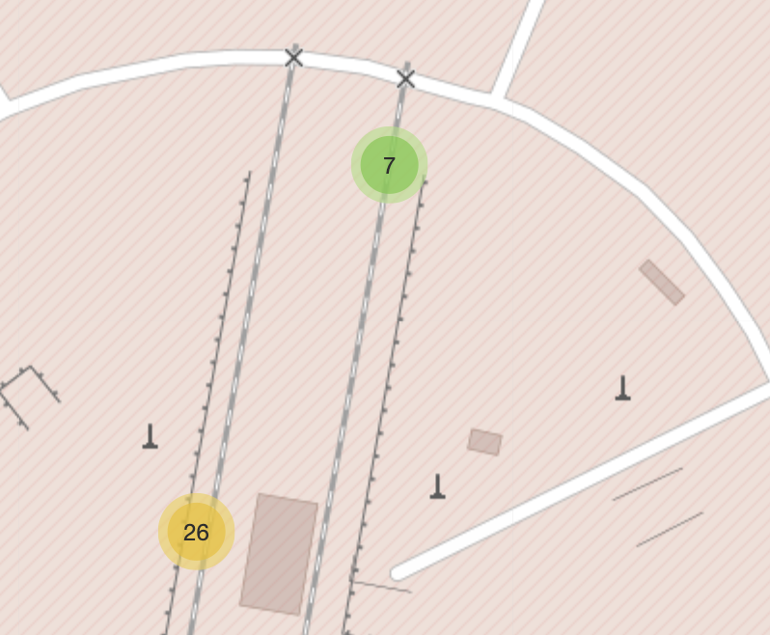
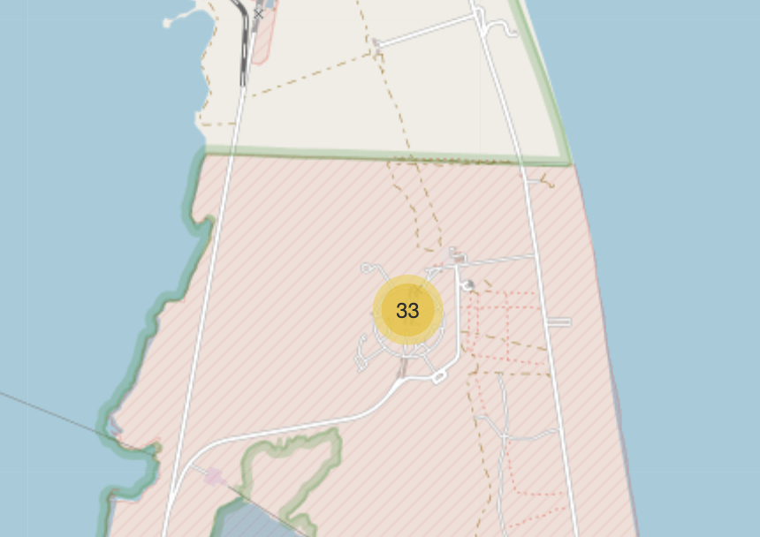
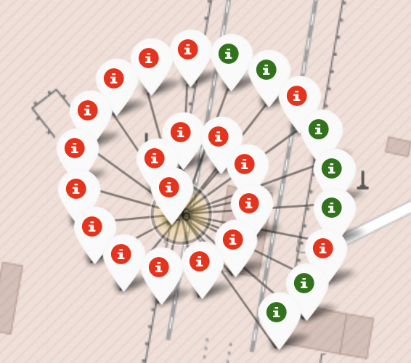
Mark the success/failed launches for each site on the map
Green = success
Red = failure

Slide 39
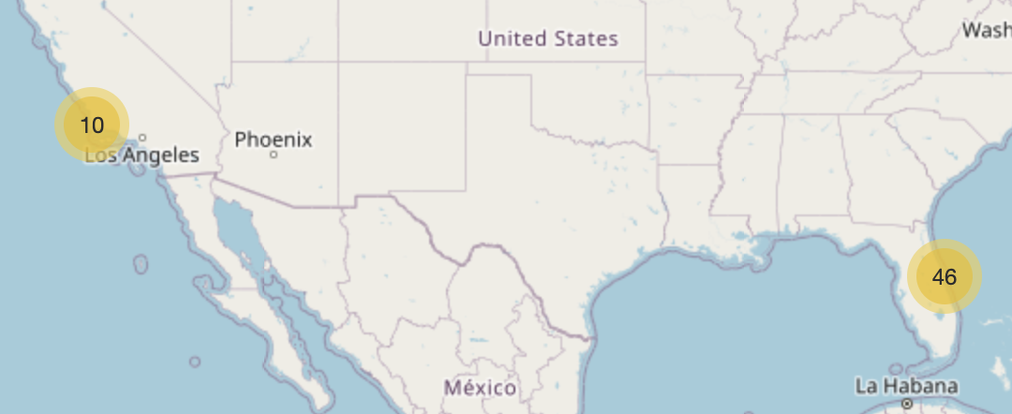
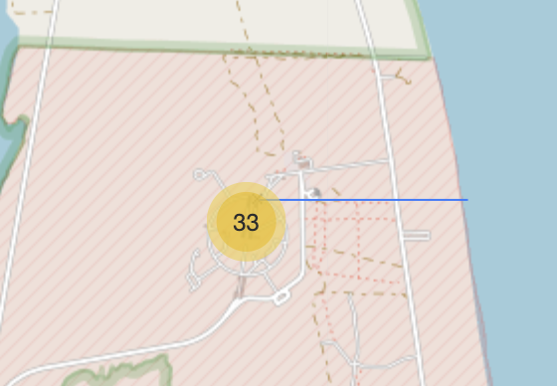
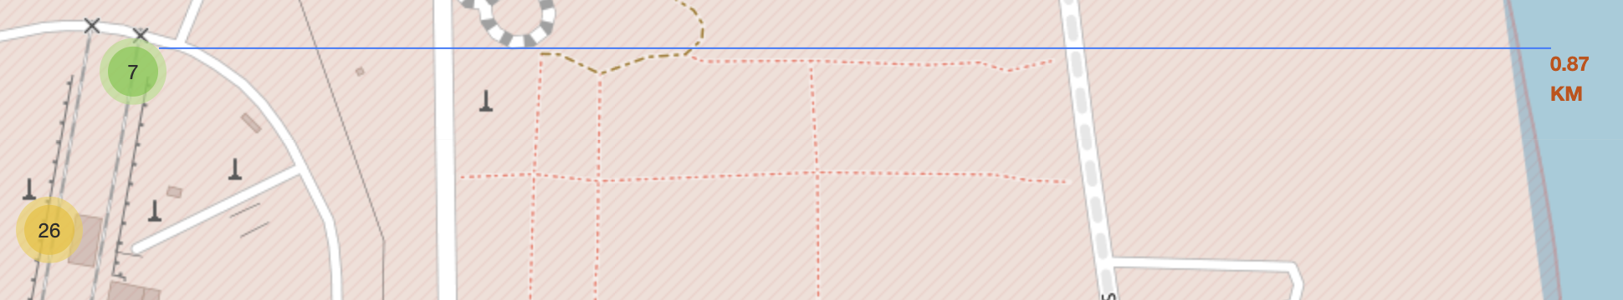
Calculate the distances between CCAFS SLC- 40 site to the nearest coastline point

Slide 40

Section 4

Slide 41
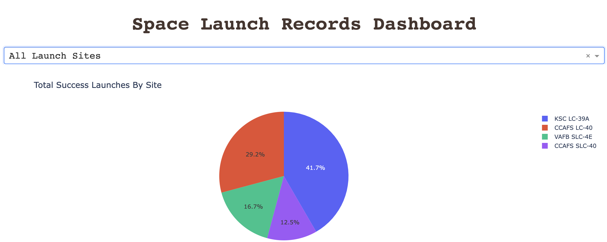
Total success launches by all sites
KSC LC-39A site has the highest success rate of landing

Slide 42
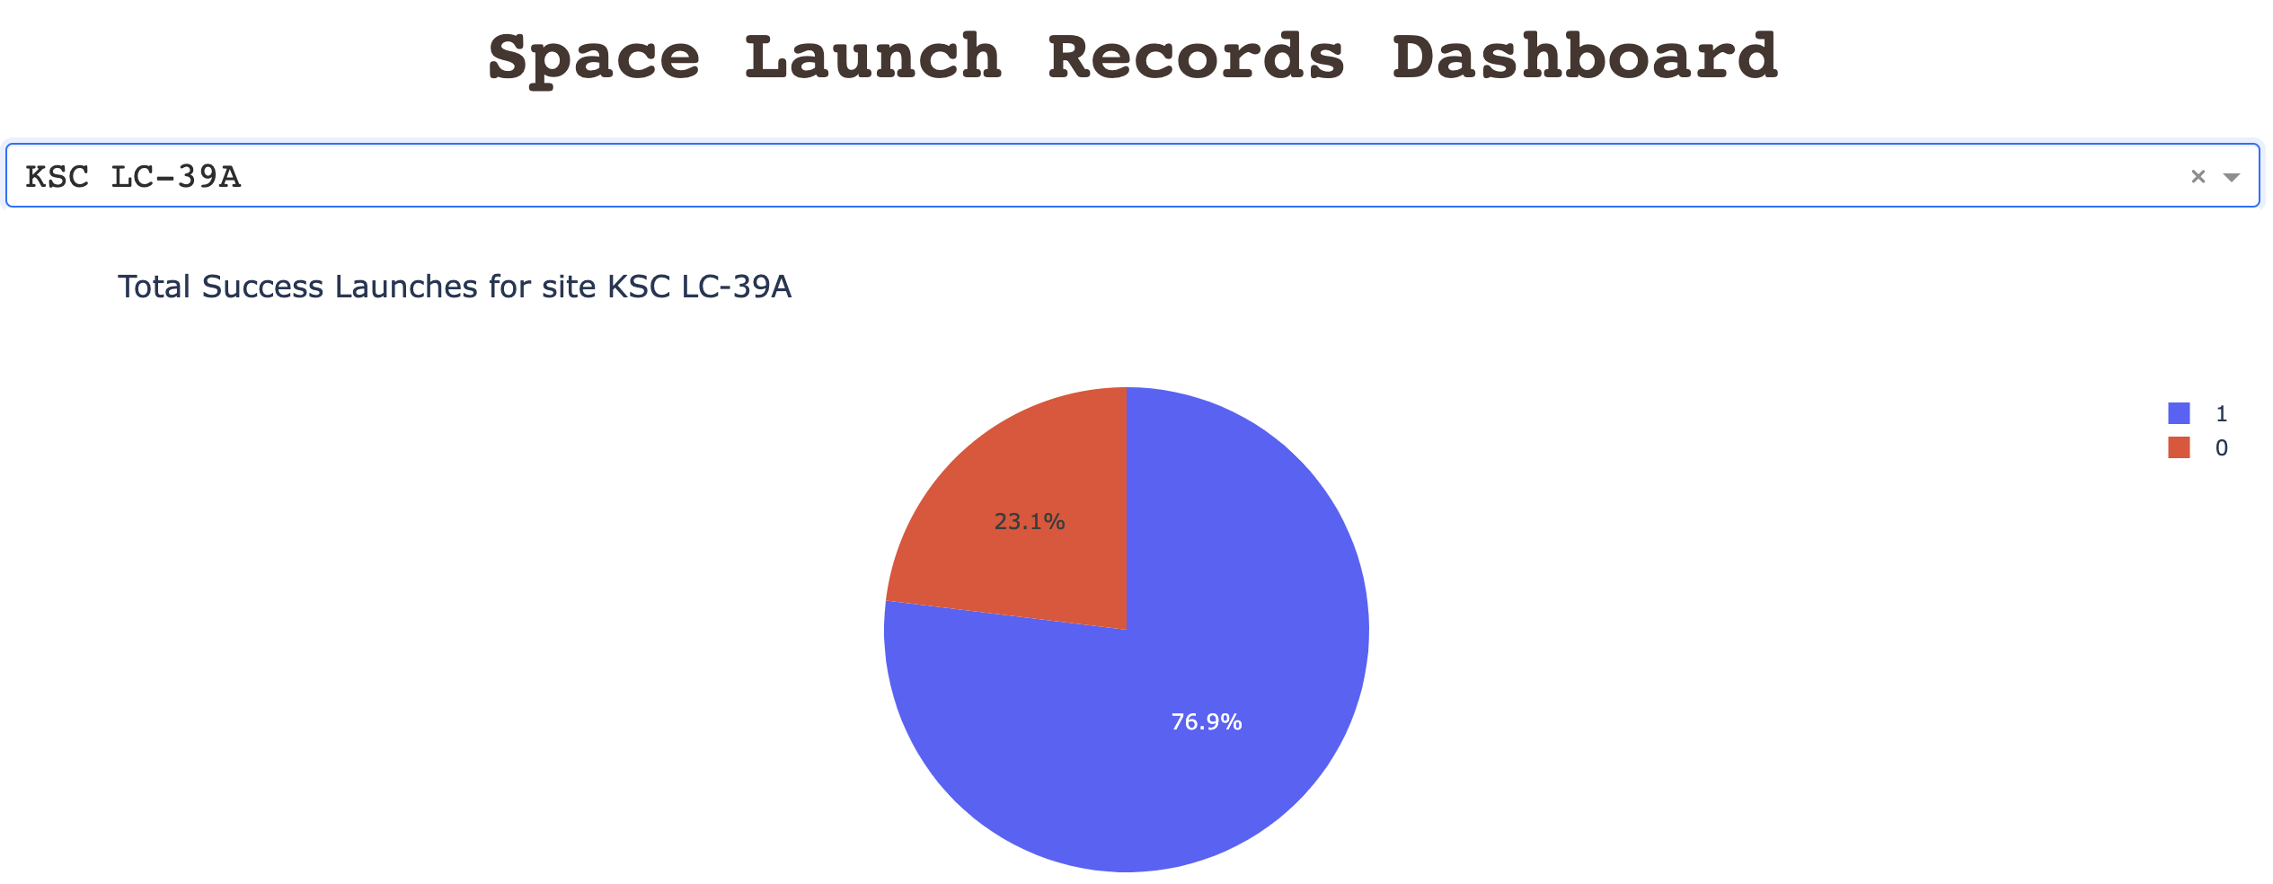
Success vs Failure rate for KSC LC-39A site
KSC LC-39A achieved a 76.9% success rate while getting a 23.1% failure rate

Slide 43
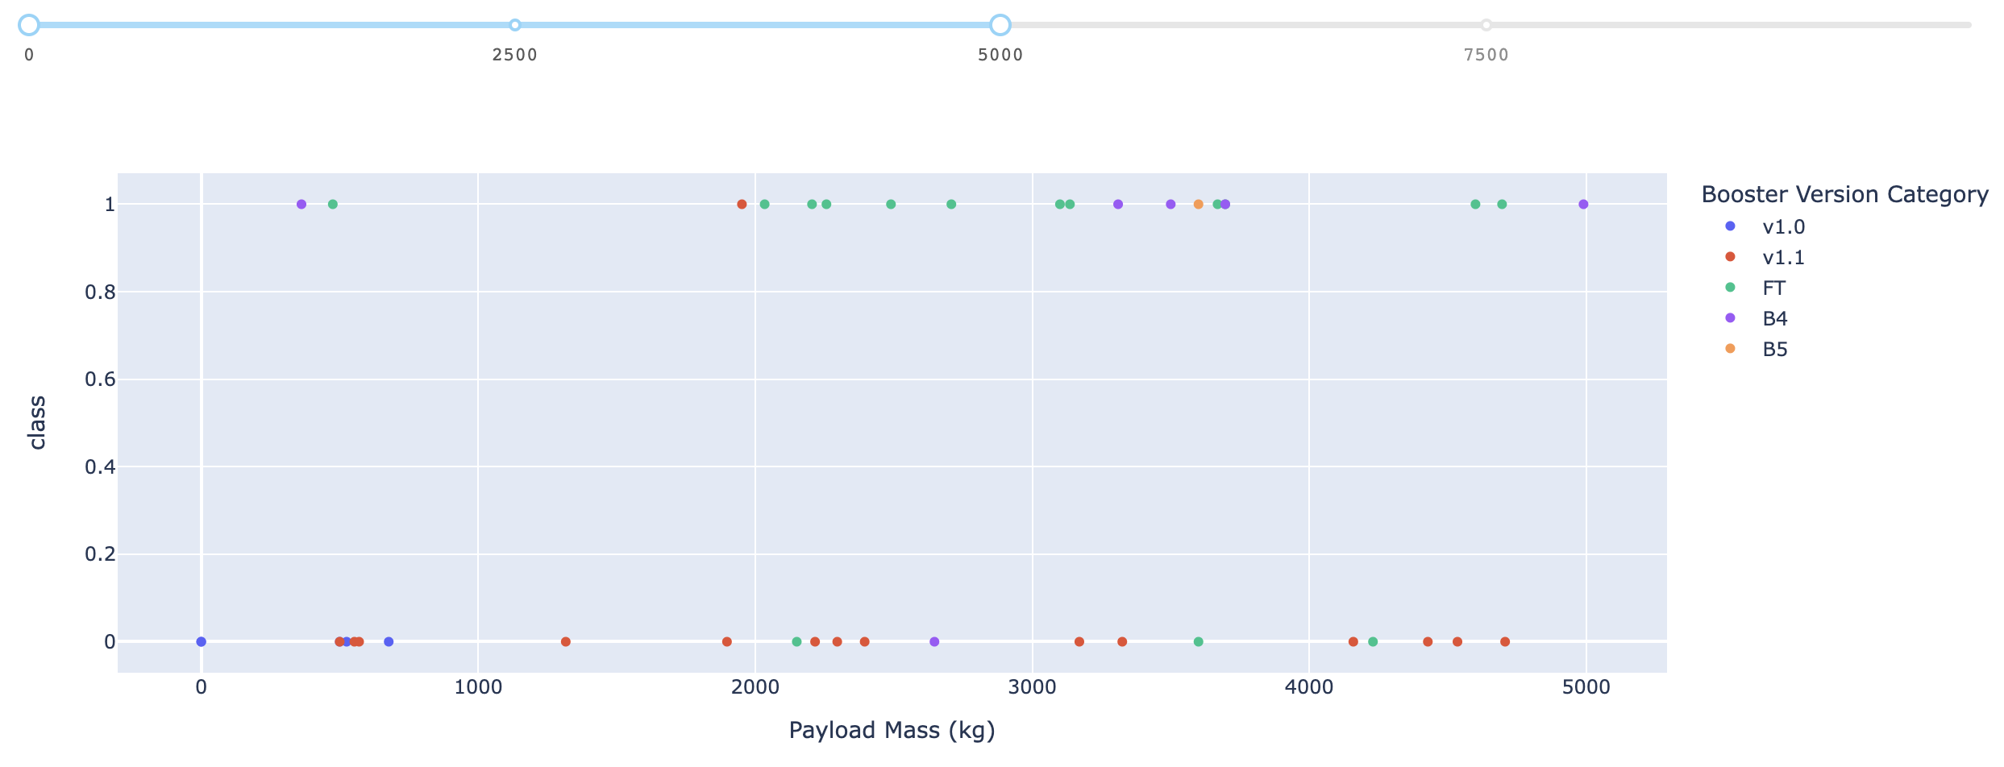
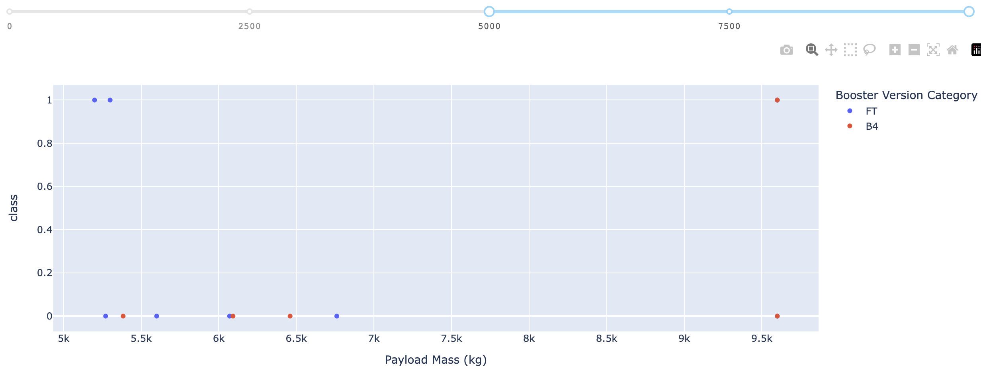
Launch outcome for different payload mass range
The top figure refers to the payloads range 0kg to 5000 kg and the bottom one range 5000kg to 10000kg
The success rate for low weighted payloads is higher than the heavy weighted payloads
The booster version categories v1.0, v1.1, B5 are not successful in landing if their weight is more than 5000kg

Slide 44

Section 5

Slide 45
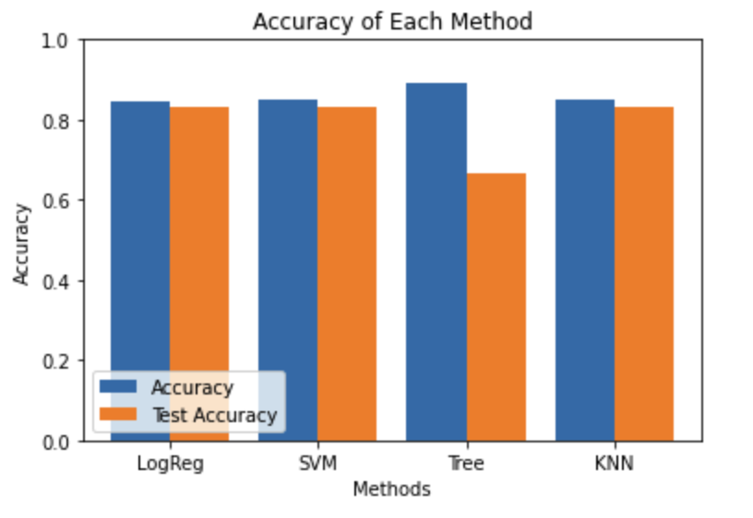
Classification Accuracy
The LogReg, SVM, and KNN tests are among the highest accurate tests

Slide 46
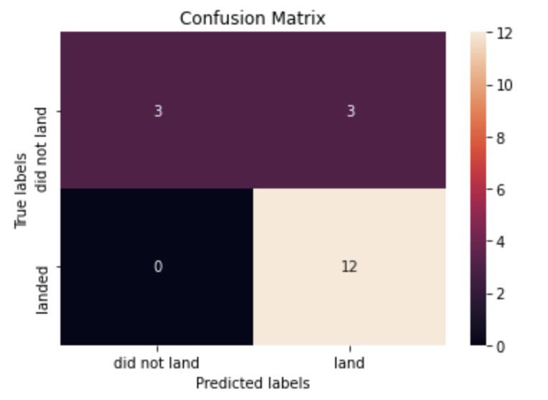
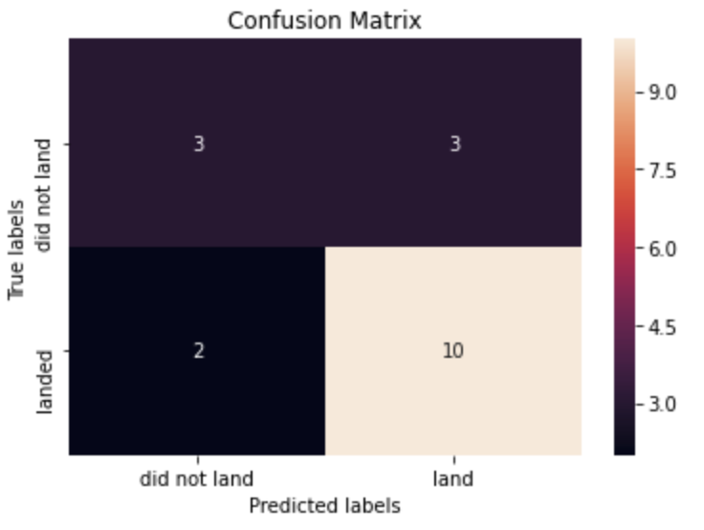
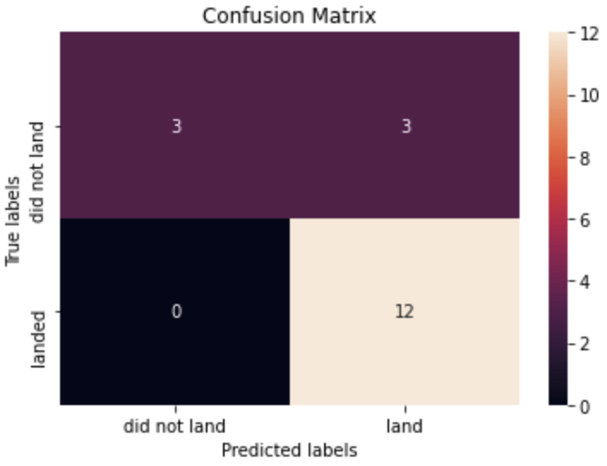
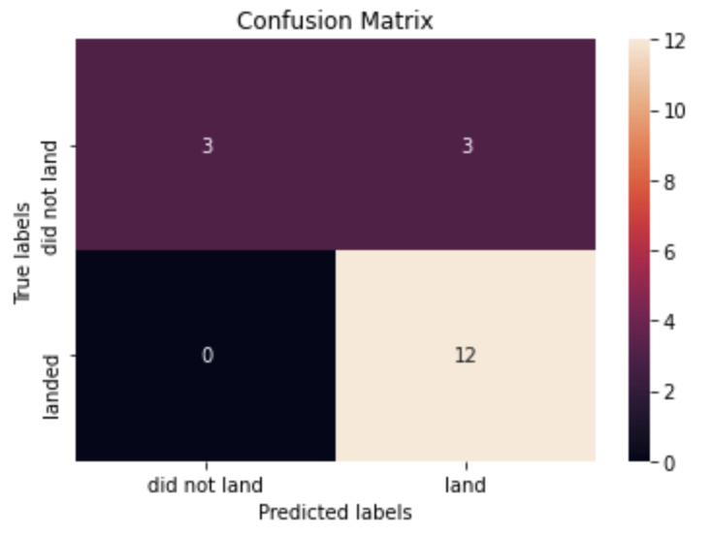
Confusion Matrices
LogReg model
Tree model
The LogReg, SVM, and KNN models are among the highest accurate models
SVM model
KNN model

Slide 47
Conclusions
Low weighted payloads perform better than those of the heavier payloads
Orbits GEO, HEO, SSO, and ES L1 are among the highest success rate orbits
KSC LC 39A has the most successful launches from all stations
The SVM, KNN, and Logistic Regression models have the best prediction accuracy for the dataset

Slide 48


